Slide 1

Psychopharmacology: Drugs, the Brain, and Behavior
by Meyer, Farrar, Biezonski, Yates

Slide 2
Chapter 17
Disorders of Anxiety and Impulsivity and the Drugs Used to Treat Them
17.1 Neurobiology of Anxiety
17.2 Characteristics of Anxiety Disorders
17.3 Drugs for Treating Anxiety, OCD, and PTSD

Slide 3
Chapter 17
Learning Objectives (1 of 3)
17.1.1 Describe the general psychological, behavioral, and physical manifestations of anxiety.
17.1.2 Detail the neurocircuitry of anxiety: the amygdala and its interactions with other limbic system structures.
17.1.3 Describe the role various neurotransmitter systems play in mediating anxiety.
17.1.4 Describe the role of genes, gender, and interactions with the environment in modulating anxiety.

Slide 4
Chapter 17
Learning Objectives (2 of 3)
17.2.1 Describe the symptoms associated with generalized anxiety disorder, panic disorder, phobias, social anxiety disorder, post-traumatic stress disorder, and obsessive–compulsive disorder.
17.2.2 Detail the current understanding of the neurobiology of these disorders.
17.2.3 Describe treatments available to combat these disorders.

Slide 5
Chapter 17
Learning Objectives (3 of 3)
17.3.1 Describe how barbiturates and benzodiazepines reduce anxiety by modulating GABA neurotransmission.
17.3.2 Detail the pharmacokinetics and side- effect profiles of barbiturates and benzodiazepines.
17.3.3 Recognize the characteristics of dependence and withdrawal from benzodiazepine abuse.
17.3.4 Describe the mechanisms of action and anxiolytic properties of neurosteroids, second-generation anxiolytics, and antidepressants.
17.3.5 Detail novel approaches to anxiety treatment, including the use of MDMA, ketamine, and hallucinogens as adjuncts to psychotherapy.

Slide 6
Neurobiology of Anxiety (1 of 22)
DSM-5 classification of anxiety disorders:
  Anxiety disorders
  Obsessive-compulsive disorder (OCD) and related disorders
  Trauma related disorders, including PTSD
Anxiety is commonly associated with other psychopathology, particularly clinical depression
Notes:
Instructor Notes:

Slide 7
Neurobiology of Anxiety (2 of 22)
What is anxiety?
Most anxiety manifests as feelings of concern or worry
Responses include increased muscle tension, restlessness, impaired concentration, sleep disturbances, and irritability
Activation of the sympathetic ANS produces increased heart rate, sweating, and other signs of “fight-or-flight” response
Intensity can vary from feelings of vague discomfort to intense sensations of terror
Notes:
Instructor Notes:

Slide 8
Neurobiology of Anxiety (3 of 22)
What is anxiety?
Evolutionarily, it’s important to survival – warns of danger and activates fight-or-flight response;
In modern life it’s a necessary stimulus for optimal performance in many situations; but when too severe, performance deteriorates, especially on complex tasks
High anxiety can lead to failure, which creates more anxiety
Anxiety and fear are different emotions
Notes:
Instructor Notes:

Slide 9
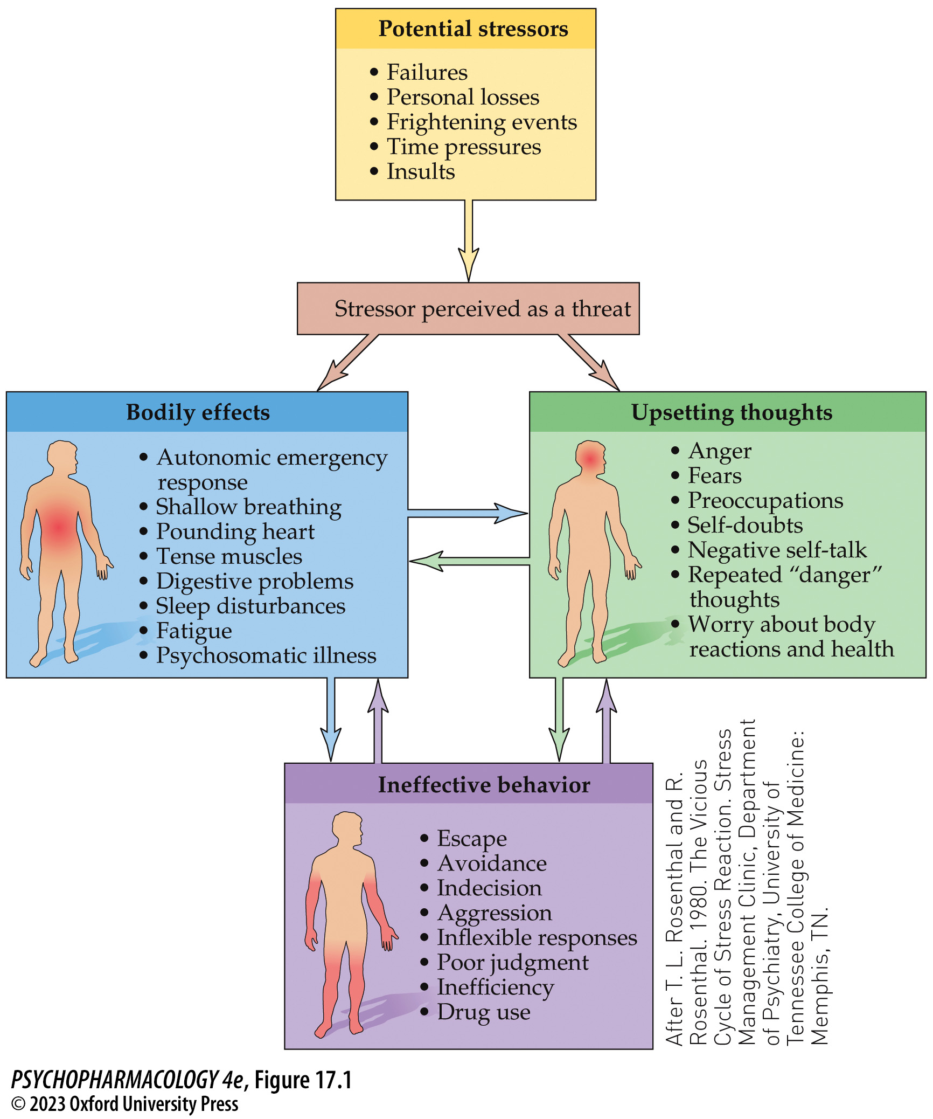
FIGURE 17.1 Three-component model of anxiety
Notes:
FIGURE 17.1 Three-component model of anxiety
Stress induces the cyclical interaction of bodily response, ineffective behavior, and upsetting thoughts. Potential stressors may be perceived as a threat that initiates portions of the anxiety responses. Each of the three components influences the others, potentially escalating the overall damaging effect of anxiety. For other individuals, the stressor may be perceived as a challenge that engages more constructive behavior. Individual differences based on genetic traits and early experience may make some people more or less vulnerable to stressors. (After T. L. Rosenthal and R. Rosenthal. 1980. The Vicious Cycle of Stress Reaction. Stress Management Clinic, Department of Psychiatry, University of Tennessee College of Medicine: Memphis, TN.)

Slide 10
Neurobiology of Anxiety (4 of 22)
The amygdala is important to emotion-processing circuits
Receives processed sensory and cognitive information from the sensory thalamus, sensory and association cortices, and hippocampus.
PET and fMRI: negative emotional stimuli activate the amygdala in humans; significantly more in people with anxiety disorders
In animals, electrical stimulation of the amygdala produces signs of anxiety and fear; bilateral lesions produce deficits in fearful responses
Notes:
Instructor Notes:

Slide 11
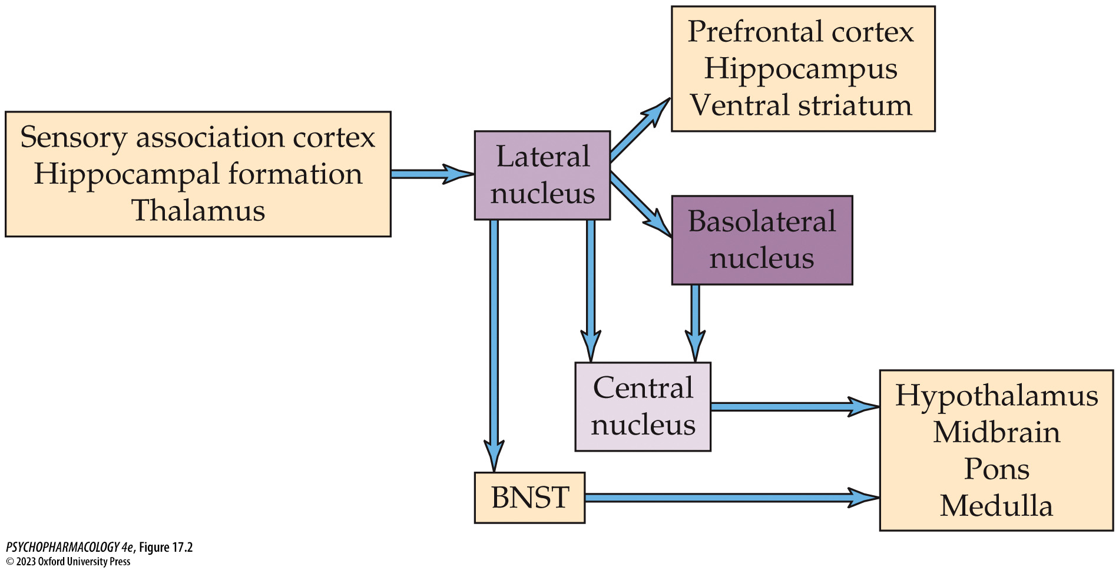
FIGURE 17.2 Flow diagram of connections of the amygdala
Notes:
FIGURE 17.2 Flow diagram of connections of the amygdala
This much-simplified diagram shows how anxiety-related information processed by several brain areas inputs first to the lateral nucleus of the amygdala. From the lateral nucleus, it goes to the central nucleus (directly and indirectly) and the bed nucleus of the stria terminalis (BNST), which innervate widespread brain regions to orchestrate the components of emotion.

Slide 12
Neurobiology of Anxiety (5 of 22)
The amygdala is important to emotion-processing circuits
Amygdala central nucleus coordinates components of emotion because it has connections to multiple brain areas
Responses in anxiety may be initiated by the BNST – it projects to the same regions as the central nucleus
Central nucleus mediates rapid response; BNST produces a state of sustained preparedness for an unclear danger
Anxiety in several animal tests is affected by manipulations of the BNST
Notes:
Instructor Notes:
BNST: bed nucleus of the stria terminalis, the “extended amygdala”

Slide 13
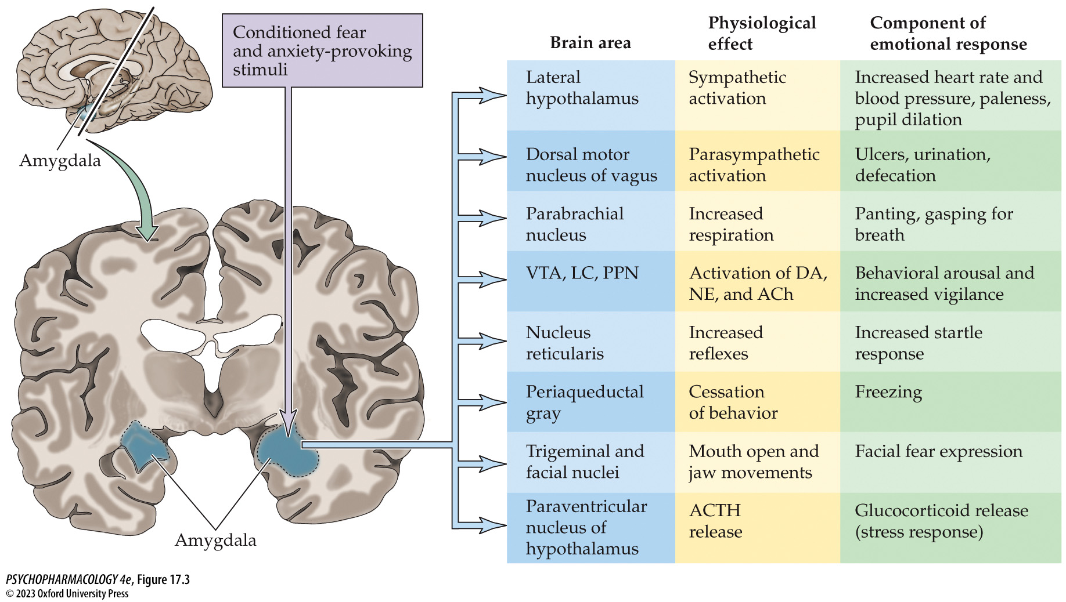
FIGURE 17.3 The amygdala coordinates components of emotion
Notes:
FIGURE 17.3 The amygdala coordinates components of emotion
The amygdala has neuronal connections with all of these brain areas that produce individual pieces of emotional expression. ACh, acetylcholine; ACTH, adrenocorticotropic hormone; DA, dopamine; LC, locus coeruleus; NE, norepinephrine; PPN, pedunculopontine nucleus; VTA, ventral tegmental area.

Slide 14
Neurobiology of Anxiety (6 of 22)
The amygdala is important to emotion-processing circuits
Amygdala aids in forming emotional memories - conditioned emotional response (CER)
Also contributes to memory consolidation via connections with the hippocampus
The PFC exerts inhibitory control over the primitive responses of subcortical regions, which allows us to cope with modern situations; anxiety disorders may be due to an imbalance between emotion generating centers and higher cortical control
Notes:
Instructor Notes:
CER: association of an environmental cue with an aversive stimulus.

Slide 15
Neurobiology of Anxiety (7 of 22)
Multiple neurotransmitters mediate anxiety: Corticotropin-releasing factor (CRF)
Released by the hypothalamus, acts on the pituitary to control release of glucocorticoids from the adrenal cortex (HPA axis) in response to stress
Glucocorticoids induce physiological changes that provide means to adapt to environmental challenges
High cortisol levels act as negative feedback to the HPA system to bring cortisol levels back to normal
CRF is also a neurotransmitter in multiple brain areas associated with anxiety; is released following threatening stimuli
Notes:
Instructor Notes:

Slide 16
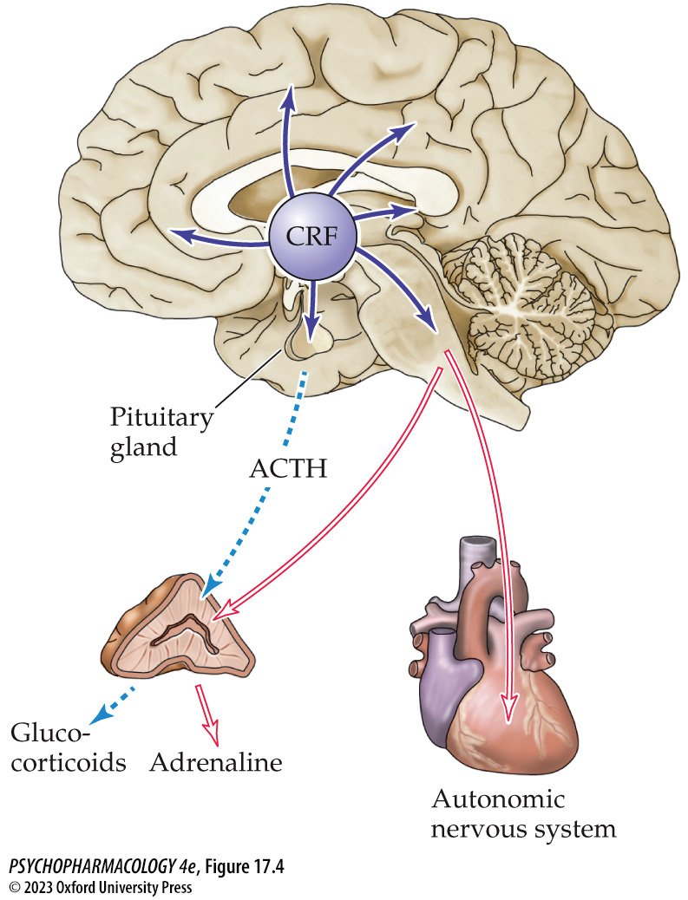
FIGURE 17.4 Dual role for CRF
Notes:
FIGURE 17.4 Dual role for CRF
Corticotropin-releasing factor (CRF) is released by the hypothalamus to act on the pituitary gland to control the release of glucocorticoids from the adrenal cortex (HPA axis) in response to stress (dashed arrow pathway). CRF also acts as a neurotransmitter in multiple brain areas associated with anxiety (solid arrow pathway) and is released following threatening stimuli. Intracerebral CRF causes behavioral signs of anxiety as well as altered autonomic nervous system function (open arrow pathways). ACTH, adrenocorticotropic hormone.

Slide 17
Neurobiology of Anxiety (8 of 22)
Multiple neurotransmitters mediate anxiety: Corticotropin-releasing factor (CRF)
In animal tests, CRF causes increased anxiety; stressful stimuli cause release of CRF in the amygdala.
Many behavioral effects can be prevented by pretreatment with a CRF antagonist
CRF neurons originating in the amygdala central nucleus project to the locus coeruleus (LC) and activate the adrenergic component of the stress response
Numerous studies indicate the significant role of the LC as a mediator of stress-induced anxiety
Notes:
Instructor Notes:

Slide 18
Neurobiology of Anxiety (9 of 22)
BOX 17.1 THE CUTTING EDGE
Toward Unraveling the Cellular and Molecular Mechanisms Underlying LC-NE Modulation of Anxiety
Induction of anxiety in mice led to a tonic elevation in neural activity in LC-NE cells
Researchers used optogenetics and a variety of tracing methods to demonstrate that stimulation of LC-NE fibers in the basolateral amygdala induces anxiety-like behavior in mice
This could be blocked by pretreatment with a β-adrenergic receptor antagonist (propranolol), implicating a role of this receptor in anxiety
Notes:
Instructor Notes:

Slide 19
Neurobiology of Anxiety (10 of 22)
Multiple neurotransmitters mediate anxiety: NE
Patients with anxiety disorders have abnormal ANS response; NE is the transmitter released during sympathetic activation
NE and epinephrine are important in formation of emotional memories
It may be possible to interfere with the formation of traumatic memories by blocking β-adrenergic receptors right after a severe trauma, or modify existing memories
Propranolol given to patients after car accidents has been successful in preventing or easing PTSD symptoms
Notes:
Instructor Notes:

Slide 20
Neurobiology of Anxiety (11 of 22)
Multiple neurotransmitters mediate anxiety: NE
Anxiolytic drug action can be explained by modulation of LC firing: LC NE cells are excited by CRF synaptic input and are inhibited by GABA, 5-HT, and by stimulation of α2-adrenergic somatodendritic autoreceptors
Benzodiazepines enhance the inhibitory function of GABA; serotonin reuptake blockade by SSRIs would also reduce LC firing
Tricyclic antidepressants enhance NE function, which inhibits firing of LC neurons by acting on α₂-autoreceptors
Notes:
Instructor Notes:
Tricyclic antidepressant: desipramine

Slide 21
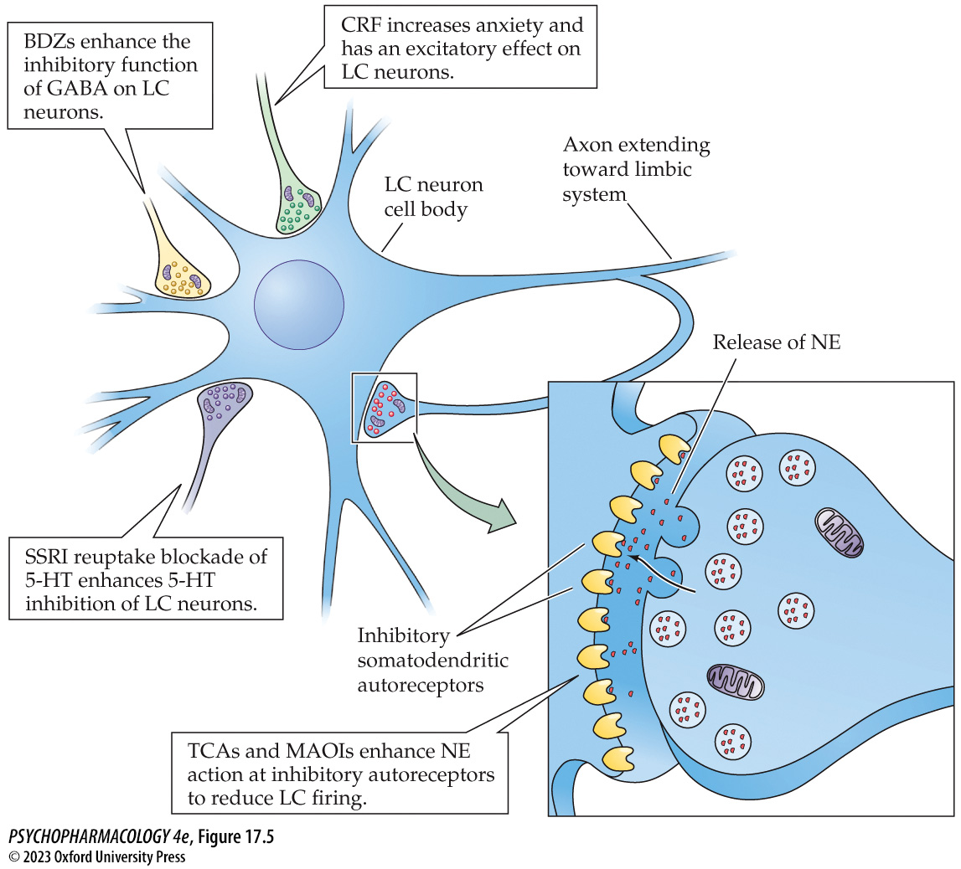
FIGURE 17.5 Drug effects on locus coeruleus (LC) cell firing (1)
Notes:
FIGURE 17.5 Drug effects on locus coeruleus (LC) cell firing
Some of the anxiolytic effects of the benzodiazepines (BDZs), tricyclic antidepressants (TCAs), monoamine oxidase inhibitors (MAOIs), and selective serotonin reuptake inhibitors (SSRIs) may be explained by their inhibitory effect on LC neurons. On the other hand, corticotropin-releasing factor (CRF) increases anxiety and has excitatory effects on the LC. CRF antagonists may be effective in reducing anxiety. 5-HT, serotonin.

Slide 22
Neurobiology of Anxiety (12 of 22)
Multiple neurotransmitters mediate anxiety: GABA
Inhibitory GABA has a major role in modulating anxiety: glutamatergic neurons from the PFC stimulate GABA neurons in the amygdala – top-down control of amygdaloid activity
Benzodiazepines (BDZ) and barbiturates bind to modulatory sites on GABA_{A} receptors to enhance function
Other modulators also enhance GABA function: alcohol, and naturally occurring neurosteroids such as allopregnanalone
Notes:
Instructor Notes:

Slide 23
Neurobiology of Anxiety (13 of 22)
Multiple neurotransmitters mediate anxiety: GABA
To study BDZ action: the receptor antagonist flumazenil prevents effects of BDZ binding; inverse agonists β-carbolines produce the opposite actions of BDZs
PET scans show that patients with panic disorder, GAD, and PTSD have less benzodiazepine binding in the CNS and are less sensitive to BDZs
Notes:
Instructor Notes:

Slide 24
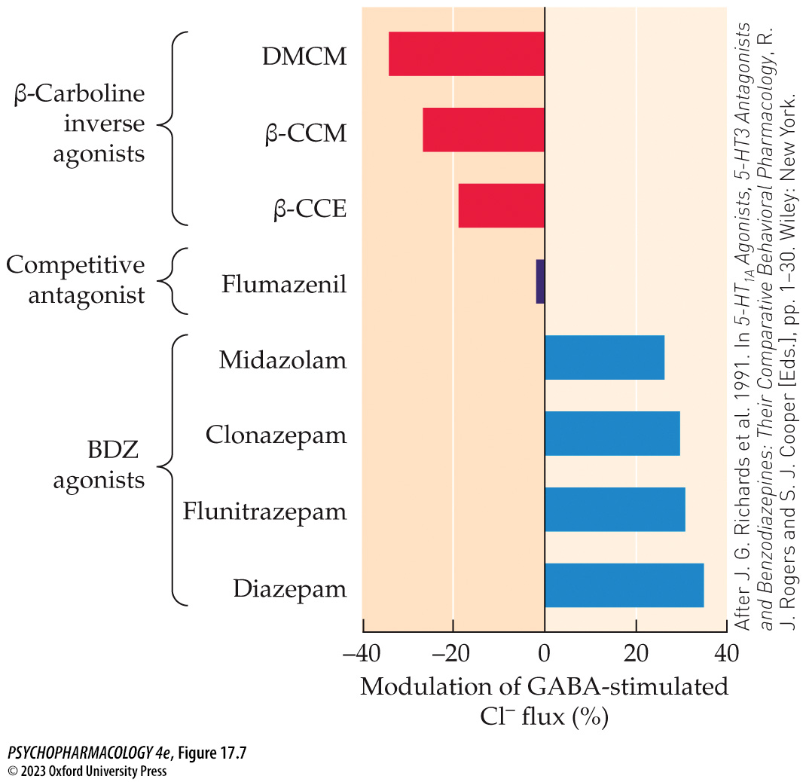
FIGURE 17.7 Modulation of GABA-induced chloride (Cl⁻) flux
Notes:
FIGURE 17.7 Modulation of GABA-induced chloride (Cl⁻) flux
The anxiolytic BDZs are agonists (blue bars) and enhance the effects of GABA. The competitive antagonist flumazenil binds to the BDZ receptor but has no action of its own. However, it prevents either the BDZs or the inverse agonists from acting. The anxiety-producing β-carbolines (red bars) are inverse agonists at the BDZ receptor. They not only prevent the effect of GABA on Cl⁻ flux but also produce the opposite effect, which leads to cell excitation. β-CCE, β-carboline-3-carboxylic acid ethyl ester; β-CCM, methyl β-carboline-3-carboxylate; DMCM, methyl 6,7-dimethoxy-4-ethyl-β-carboline-3-carboxylate. (After J. G. Richards et al. 1991. In 5-HT_{1A} Agonists, 5-HT3 Antagonists and Benzodiazepines: Their Comparative Behavioral Pharmacology, R. J. Rogers and S. J. Cooper [Eds.], pp. 1–30. Wiley: New York.)

Slide 25
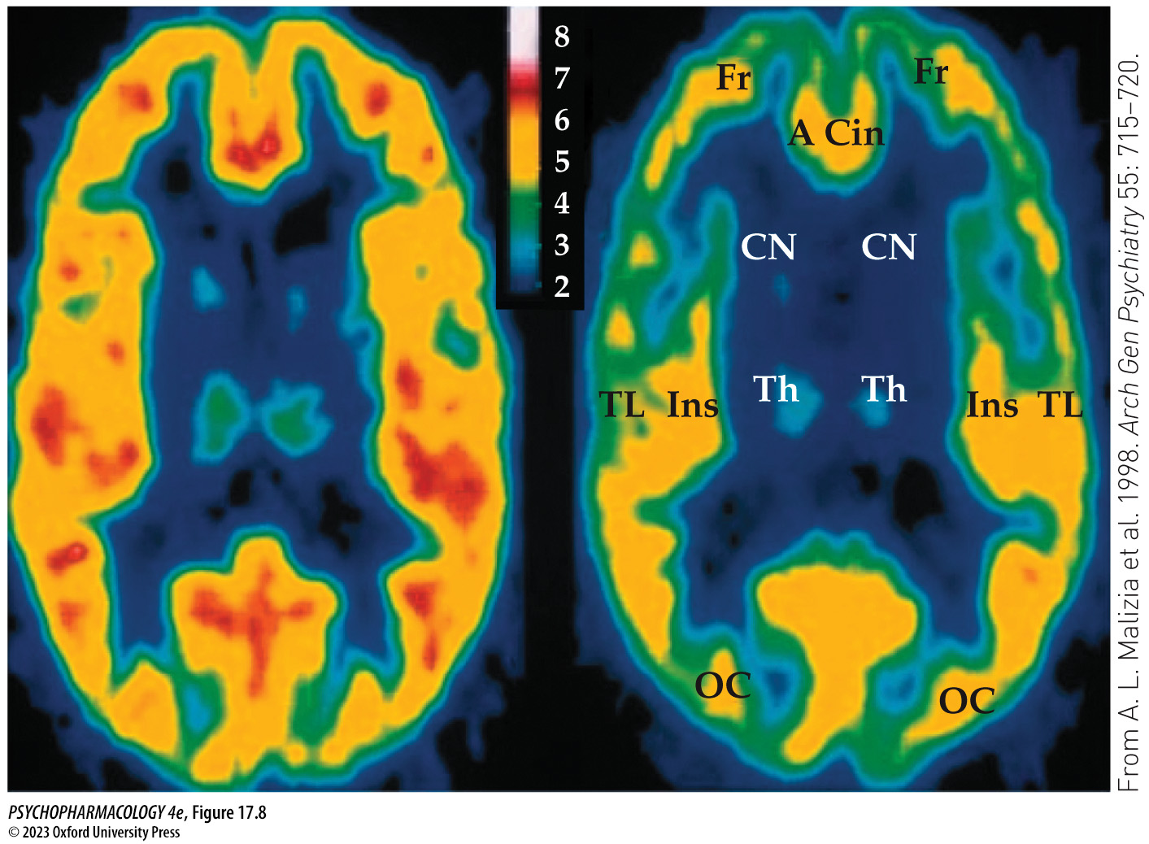
FIGURE 17.8 PET scans of a control individual (left) and a patient with panic disorder (right)
Notes:
FIGURE 17.8 PET scans of a control individual (left) and a patient with panic disorder (right)
The scans made in the horizontal plane with the frontal cortex at the top show decreased density of BDZ binding sites in the patient with panic disorder, particularly in the frontal cortex (Fr), anterior cingulate (A Cin), and insula (Ins), areas important in anxiety modulation. Other brain areas also show reduced numbers of BDZ binding sites. Warm colors indicate the most receptors; cool colors indicate fewer. Receptors were labeled with [¹¹C]flumazenil. CN, caudate nucleus; OC, occipital cortex; Th, thalamus; TL, temporal lobe.

Slide 26
Neurobiology of Anxiety (14 of 22)
Multiple neurotransmitters mediate anxiety: neurosteroids
Allopregnanolone binds to a separate site on GABA_{A} receptors and increases duration of GABA-induced Cl– channel opening
Baseline levels of neurosteroids are elevated in panic disorder but drop when a panic attack is induced, indicating reduced GABA control of the anxiety
Neurosteroid levels tend to be lower in individuals with GAD and social phobia
Neurosteroid levels may be used to distinguish among anxiety disorders
Notes:
Instructor Notes:

Slide 27
Neurobiology of Anxiety (15 of 22)
Multiple neurotransmitters mediate anxiety: serotonin
5-HT modulates anxiety in a complex fashion
Injections of 5-HT_{1A} agonists show that the site of injection determines outcome:
  Hippocampus or amygdala, 5-HT_{1A} receptors are located postsynaptically—anxious behaviors increase
  Raphe nuclei, 5-HT_{1A} receptors are somatodendritic autoreceptors—an anxiolytic effect results
Individuals with anxiety disorders show reduced 5-HT_{1A} binding in the raphe
Notes:
Instructor Notes:

Slide 28
Neurobiology of Anxiety (16 of 22)
Multiple neurotransmitters mediate anxiety: serotonin
SSRIs block reuptake of 5-HT, prolonging its effects; may initially increase anxiety but over several weeks produces neuronal adaptations and therapeutic effect
The neurotrophic effect of 5-HT is needed for normal fetal development
A polymorphism in the promoter of the 5-HT transporter gene results in higher prenatal 5-HT levels; individuals show increased emotionality, reduced volume of the amygdala and ACC, and weaker connections between these structures as adults
Notes:
Instructor Notes:
SSRIs: selective serotonin reuptake inhibitors

Slide 29
Neurobiology of Anxiety (17 of 22)
Multiple neurotransmitters mediate anxiety: dopamine
DA projections from the VTA to the mPFC and limbic regions that are activated by threatening stimuli reduce inhibitory control from the mPFC and increase emotional responses
DA release reduces inhibitory control of local GABA interneurons, which increases amygdaloid activation
Phasic burst firing by VTA cells is increased by stress and correlated with enhanced DA release, especially in the Nacc; chronic activation persisting when threats are no longer present may predict dysfunctional responses in social interaction
Notes:
Instructor Notes:

Slide 30
Neurobiology of Anxiety (18 of 22)
Genes and environment interact to modulate anxiety
Levels of trait anxiety vary among individuals; reasonably consistent over one’s lifetime; indicates genetically determined brain differences
Rodents vary in innate anxiety level; inbred strains are used to study the neurobiology and treatment of anxiety
Family and twin studies estimate heritability of anxiety disorders at 30% to 60%
Animal and human studies: early exposure to stress and neglect alters the developing brain and can produce lifelong enhanced anxiety
Notes:
Instructor Notes:
Trait anxiety: the enduring characteristic to experience anxiety in a variety of situations, a personality trait

Slide 31
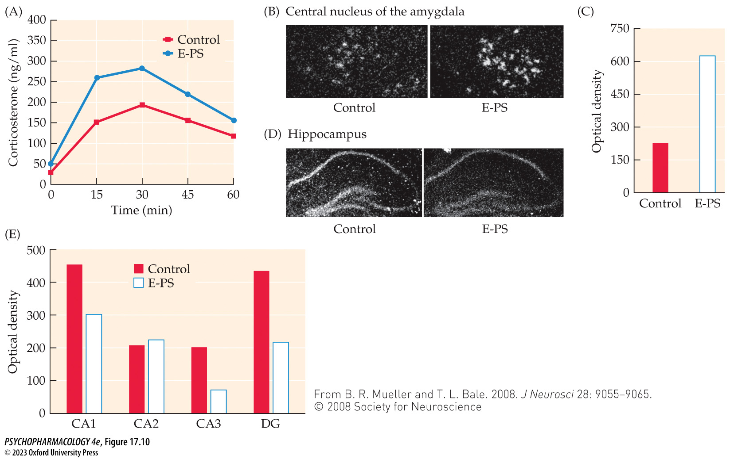
FIGURE 17.10 Stress pathway dysregulation following early prenatal stress
Notes:
FIGURE 17.10 Stress pathway dysregulation following early prenatal stress
(A) Adult male mice exposed to early prenatal stress (E-PS) during the first 7 days of gestation showed elevated blood levels of corticosterone (the principal glucocorticoid in rodents) after 15 minutes of restraint stress compared with controls, indicating an increased HPA axis function. (B,C) In situ hybridization showed significantly increased CRF expression in the central nucleus of the amygdala in adult male E-PS mice compared with controls, indicating an enhancement of stress neurocircuitry. (D,E) In situ hybridization showed glucocorticoid receptors were significantly less expressed in the CA3 and dentate gyrus (DG) regions of the hippocampus in E-PS adult male mice compared with controls, indicating a reduction in HPA axis negative feedback. Glucocorticoid receptor expression was less, but not significantly, in the CA1 region, and there was no difference in CA2. (From B. R. Mueller and T. L. Bale. 2008. J Neurosci 28: 9055–9065. © 2008 Society for Neuroscience.)

Slide 32
Neurobiology of Anxiety (19 of 22)
Genes and environment interact to modulate anxiety
Early stress also alters the HPA axis, causing a hyperactive hormonal response to challenge that persists throughout adulthood; may be due to epigenetic factors
Prolonged stress apparently produces opposite effects on the hippocampus, where synaptic structures atrophy, and on the amygdala, where dendritic growth, increased arborization, and increased spine connectivity are seen
Notes:
Instructor Notes:

Slide 33
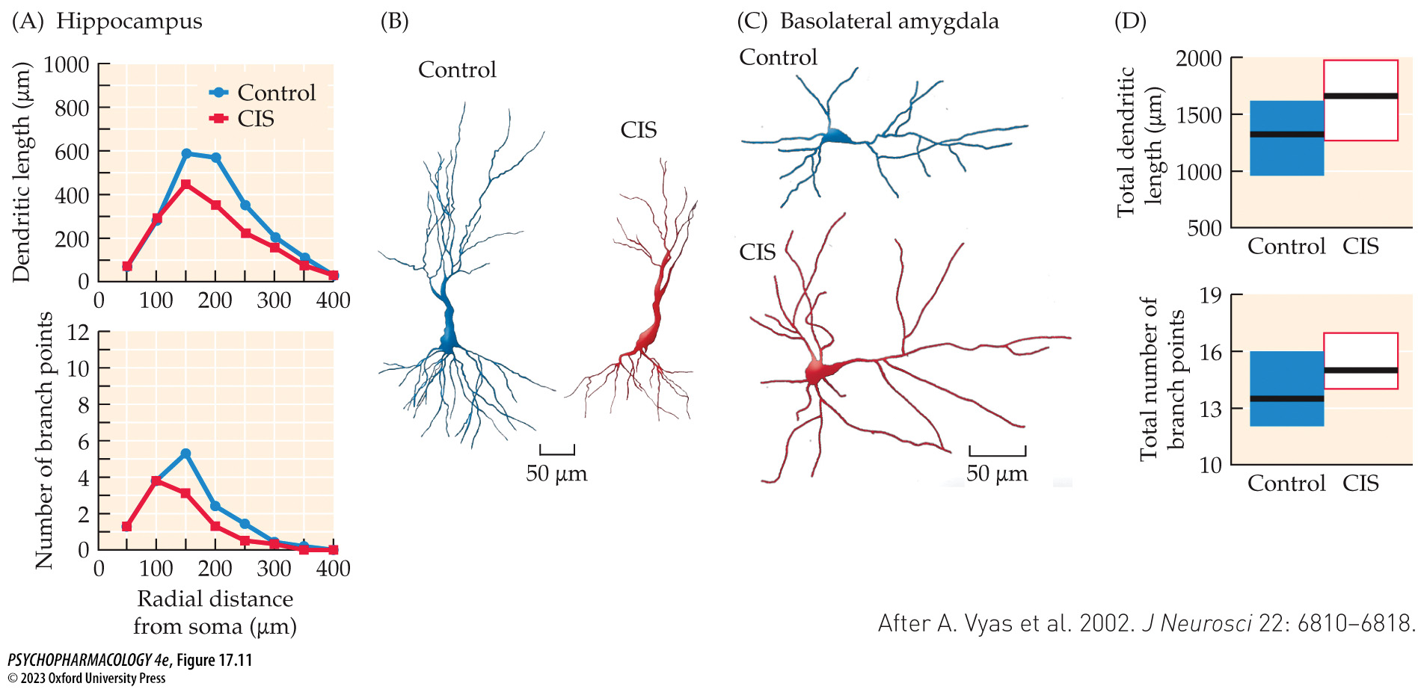
FIGURE 17.11 Effects of 10 days of chronic immobilization stress on dendritic length and complexity in the hippocampus and basolateral amygdala
Notes:
FIGURE 17.11 Effects of 10 days of chronic immobilization stress on dendritic length and complexity in the hippocampus and basolateral amygdala
(A) Chronic immobilization stress (CIS) rats compared with controls showed decreased length (top) and number of branch points (bottom) of hippocampal apical dendrites. (B) Drawings of neurons processed with Golgi staining for computerized image analysis show clearly the shrinkage and reduced dendritic complexity in hippocampal neurons of stressed rats compared with controls.
(C) Similar drawings of neurons from the basolateral amygdala show the increased length and branching in animals exposed to CIS compared with controls. (D) Plots of median values and ranges for the length (top) and number of branch points (bottom) of basolateral amygdala neurons from control and CIS rats. (After A. Vyas et al. 2002. J Neurosci 22: 6810–6818.)

Slide 34
Neurobiology of Anxiety (20 of 22)
The effects of early stress are dependent on timing
Nervous system development continues throughout gestation and even after birth; the PFC is not fully mature until adolescence
Human and animal studies are providing information on the effects of stress at different stages of development.
Notes:
Instructor Notes:

Slide 35
Neurobiology of Anxiety (21 of 22)
The effects of early stress vary with gender
Brain imaging has shown significant differences in structure and neurotransmitter systems in males and females.
Women have higher rates of anxiety disorders, though this may not hold true for social anxiety disorder; some differences may be explained by sociocultural influences.
Hormonal changes during the menstrual cycle impact HPA axis function; when estrogen levels are elevated, sensitivity to stress is greater, and glucocorticoid release is increased.
Notes:
Instructor Notes:

Slide 36
Neurobiology of Anxiety (22 of 22)
CLICKER QUESTION 1
Which area of the brain plays an important role in initiating sustained emotional responses in preparation for an unclear danger?
Central nucleus of the amygdala
Prefrontal cortex
BNST
Hippocampus
Notes:
Instructor Notes:
Correct answer: c

Slide 37
Review of Learning Objectives (1 of 3)
17.1.1 Describe the general psychological, behavioral, and physical manifestations of anxiety.
17.1.2 Detail the neurocircuitry of anxiety: the amygdala and its interactions with other limbic system structures.
17.1.3 Describe the role various neurotransmitter systems play in mediating anxiety.
17.1.4 Describe the role of genes, gender, and interactions with the environment in modulating anxiety.

Slide 38
Characteristics of Anxiety Disorders (1 of 10)
Generalized anxiety disorder
Symptoms of anxiety have no real focus; can be present for months or years; constant worry and anticipation of dreadful events; reduces the individual’s performance on many tasks and decreases pleasure
Chronic anxiety in GAD is associated with enlargement and hyperactivity of the amygdala and too little inhibitory control by the PFC
Notes:
Instructor Notes:

Slide 39
Characteristics of Anxiety Disorders (2 of 10)
Panic attacks and panic disorder with anticipatory anxiety
Panic attack: individual experiences effects of a fear reaction in the absence of a threatening stimulus
If in response to a particular environmental cue, it produces a phobia
Panic disorder: individuals have panic attacks (without warning or in a situation where an attack occurred previously) and anticipatory anxiety – worry that they may have an attack in a place that is not safe; can lead to agoraphobia, fear of public places
Notes:
Instructor Notes:

Slide 40
Characteristics of Anxiety Disorders (3 of 10)
Panic attacks and panic disorder with anticipatory anxiety
A genetic predisposition for panic is well documented
Dysregulation of adrenergic neurons in the ANS and LC may be involved; a polymorphism of the NE transporter gene is associated with increased vulnerability to panic
Amygdala and hippocampus volumes are reduced
During a panic attack, neural activity increases in the amygdala, cingulate cortex, and insula, and is reduced in the PFC
Notes:
Instructor Notes:

Slide 41
Characteristics of Anxiety Disorders (4 of 10)
Phobias
Fears that the individual recognizes as irrational; may focus on specific objects or situations such as high places
What people fear is at least partially determined by culture, e.g., pa-leng in Chinese culture
Can be treated with behavior therapy: presenting the fear-inducing stimulus in gradual increments - behavioral desensitization; sometimes uses virtual reality settings
Notes:
Instructor Notes:

Slide 42
Characteristics of Anxiety Disorders (5 of 10)
Social anxiety disorder (SAD)
Also known as social phobia; extreme fear of being evaluated or criticized by others
Sufferers tend to avoid most interpersonal situations or, if unavoidable, suffer extreme anxiety, which may take the form of a panic attack
Like other anxiety disorders, there is increased activity in the amygdala, and other limbic areas which would lead to the anticipatory anxiety and autonomic response
Notes:
Instructor Notes:

Slide 43
Characteristics of Anxiety Disorders (6 of 10)
Posttraumatic stress disorder (PTSD)
After witnessing severely traumatic events (e.g., war, natural disasters), an individual feels fear and senses of helplessness and horror; experiences nightmares and flashbacks about the event
Other symptoms: reactivity to reminders of the trauma, sleep disturbances, avoidance of stimuli associated with the trauma, numbing of emotional responses; can last for many years
Some people have sudden outbursts of irritability
Increased probability of attempting suicide, substance abuse, marital problems, depression, feelings of guilt and anger
Notes:
Instructor Notes:

Slide 44
Characteristics of Anxiety Disorders (7 of 10)
Posttraumatic stress disorder (PTSD)
PTSD is related to the intensity of the trauma but not all trauma victims develop PTSD
Genetic component: concordance in monozygotic twins; as many as 74% of PTSD sufferers had a family history of PTSD, anxiety, depression, or antisocial behavior
Women have a greater incidence of PTSD than men; chronic stress, abuse, or trauma also increases vulnerability
Notes:
Instructor Notes:

Slide 45
Characteristics of Anxiety Disorders (8 of 10)
Posttraumatic stress disorder (PTSD)
Low blood cortisol is a marker of vulnerability; in PTSD the normal feed-back mechanism that turns off cortisol and ACTH secretion is hypersensitive, related to high density of glucocorticoid receptors
Imaging studies: reduced volume of hippocampus; amygdala shows increased neural activity, and the ACC and mPFC are less active and fail to inhibit the limbic structures.
Notes:
Instructor Notes:

Slide 46
Characteristics of Anxiety Disorders (9 of 10)
Obsessive–compulsive disorder (OCD)
Recurring, persistent, intrusive thoughts of contamination, violence, sex, or religion (obsessions) that the individual tries to resist but that cause a great deal of anxiety, guilt, and shame.
Compulsions are repetitive rituals to relieve the tremendous anxiety generated by the obsessive thoughts
The individual is convinced that unless the compulsive ritual is completed, disastrous consequences will occur; they recognize that the compulsions are inappropriate or irrational
Notes:
Instructor Notes:

Slide 47
Characteristics of Anxiety Disorders (10 of 10)
Obsessive–compulsive disorder (OCD)
The caudate nucleus has a central role in the pathophysiology of OCD; it is a component in the dysfunctional cortico-striatal-thalamic-cortical loop
Some animals engage in repetitious and meaningless behaviors, providing naturalistic models of OCD
Transgenic animal models have also been developed
Animal models can be used with optogenetic and electrophysiology techniques to clarify the pathophysiology of OCD-like symptoms
Notes:
Instructor Notes:

Slide 48
Review of Learning Objectives (2 of 3)
17.2.1 Describe the symptoms associated with generalized anxiety disorder, panic disorder, phobias, social anxiety disorder, post-traumatic stress disorder, and obsessive–compulsive disorder.
17.2.2 Detail the current understanding of the neurobiology of these disorders.
17.2.3 Describe treatments available to combat these disorders.

Slide 49
Drugs for Treating Anxiety, OCD, and PTSD (1 of 10)
Anxiolytics: drugs to relieve anxiety; many are sedative–hypnotic drugs, which are CNS depressants
An anxiolytic should relieve tension, worry, and stress with minimal side effects such as sedation
Primary mechanism of action: enhancing GABA transmission
BDZs and barbituates have binding sites on GABA_{A} receptors – enhance the hyperpolarization caused by GABA by increasing the number of times the channel opens
Notes:
Instructor Notes:

Slide 50
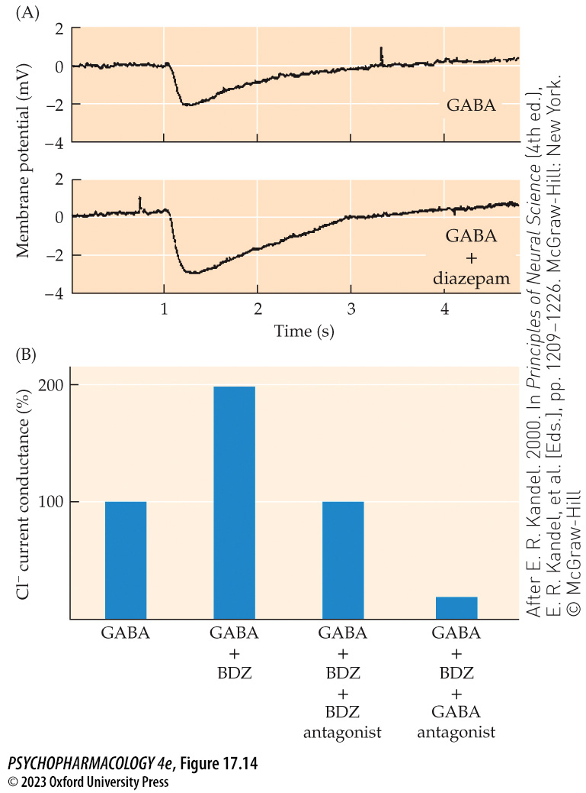
FIGURE 17.14 Effects of GABA and diazepam on membrane potentials and chloride (Cl⁻) flux
Notes:
FIGURE 17.14 Effects of GABA and diazepam on membrane potentials and chloride (Cl⁻) flux
(A) Electrical recording of the hyperpolarizing effect of GABA and the enhanced hyperpolarization caused by the addition of diazepam to a mouse spinal cord neuron. Diazepam alone would produce little or no hyperpolarization. (B) GABA alone increases the conductance of Cl⁻ through its channel. Adding a BDZ enhances the amount of Cl⁻ movement into the cell. Blocking the BDZ binding site prevents the drug’s enhancement of GABA but not the effect of GABA itself. A GABA antagonist prevents GABA from opening the Cl⁻ channel, and the presence of BDZ has no effect. (After E. R. Kandel. 2000. In Principles of Neural Science (4th ed.), E. R. Kandel, et al. [Eds.], pp. 1209–1226. McGraw-Hill: New York. © McGraw-Hill)

Slide 51
Drugs for Treating Anxiety, OCD, and PTSD (2 of 10)
Barbiturates are the oldest sedative–hypnotics
Have been replaced by BDZs for treatment of anxiety disorders; still used for anesthesia and seizure control
Side effects: induces sleep but reduces amount of REM sleep; mental clouding, loss of judgment, slowed reflexes
High doses – intoxication, coma and death from respiratory depression; extremely dangerous with alcohol
Chronic use increases liver microsomal enzymes, enhancing drug metabolism and reducing effectiveness
Tolerance develops and the margin of safety (therapeutic index) declines; dependence produces potential for abuse
Notes:
Instructor Notes:

Slide 52
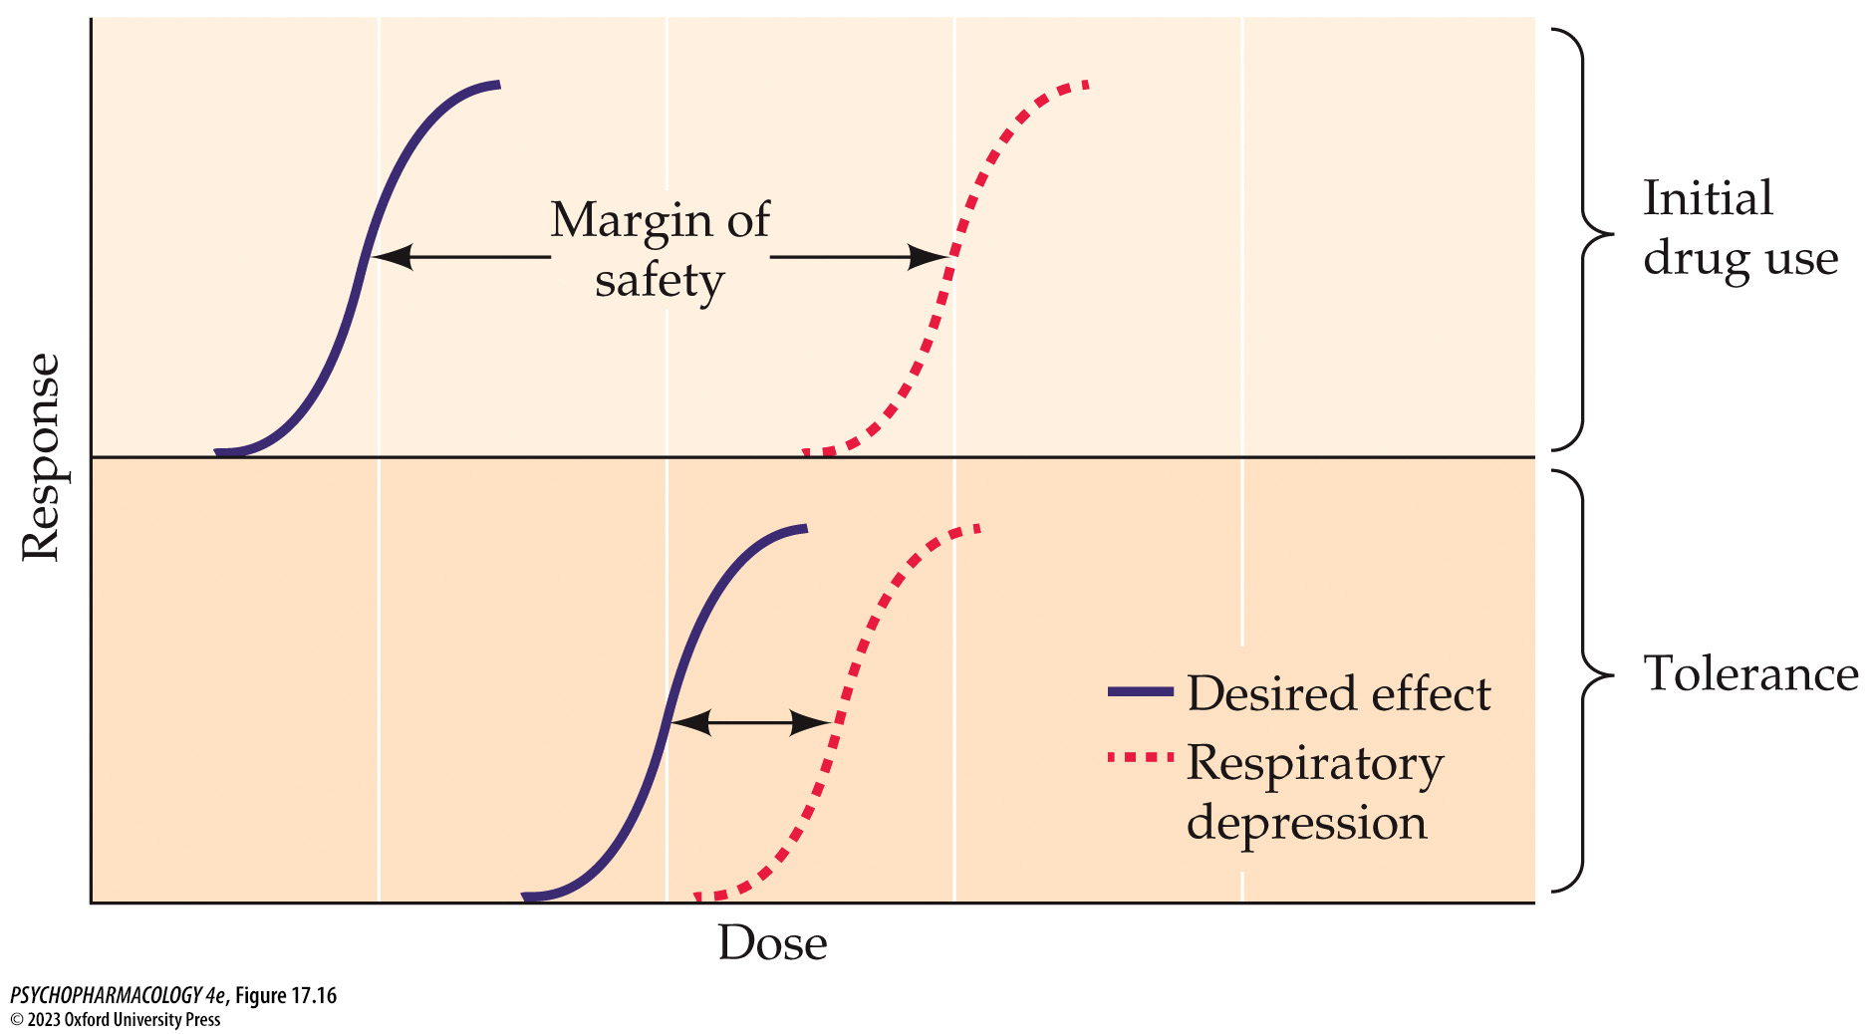
FIGURE 17.16 Margin of safety
Notes:
FIGURE 17.16 Margin of safety
Dose–response curves for the barbiturate-induced desired effect (mood change or sedation) and lethal respiratory depression. The top panel shows that with early drug use (nontolerant), the individual experiences mood effects without significant respiratory depression. However, as tolerance develops with repeated use (bottom panel), larger amounts of drug are needed to experience the sedation (the curve shifts to the right), but no change in the dose causing depression of respiration occurs. The margin of safety shrinks dramatically in the tolerant individual.

Slide 53
Drugs for Treating Anxiety, OCD, and PTSD (3 of 10)
BDZs are highly effective for anxiety reduction
Don’t have the undesirable side effects of barbiturates: less tolerance, less severe withdrawal, and safe therapeutic index
BDZ choice based on speed of onset (determined by lipid solubility) and duration of drug action (depends on liver metabolism)
Presurgical anesthetics – relax patient before surgery or dental work; midazolam (Versed) rapid onset for brief surgical procedures –short half-life and rapid recovery
Notes:
Instructor Notes:
Some BDZs: chlordiazepoxide (Librium), diazepam (Valium), oxazepam (Serax), flurazepam (Dalmane), temazepam (Restoril), lorazepam (Ativan), midazolam (Versed)

Slide 54
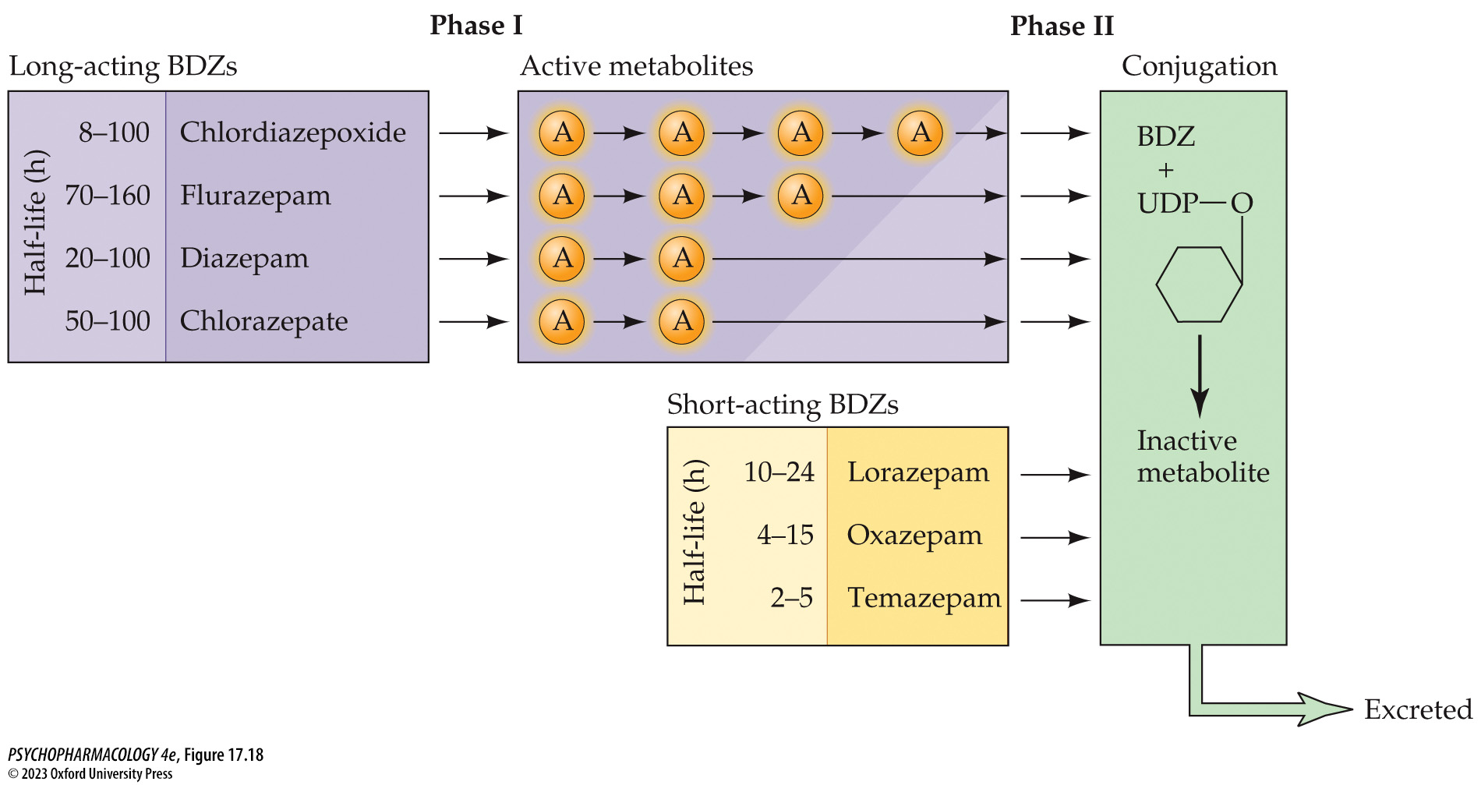
FIGURE 17.18 BDZ metabolism
Notes:
FIGURE 17.18 BDZ metabolism
The long-acting BDZs (lavender) undergo several metabolic changes (phase I) that create active metabolites (A) before finally being conjugated (phase II) with glucuronide to form water-soluble inactive metabolites (green) that are excreted. These drugs remain in the body for long periods of time. The short-acting BDZs (yellow) are often metabolized in a single step by conjugation with glucuronide to an inactive metabolite and are cleared quickly from the body. UDP, uridine diphosphate.

Slide 55
Drugs for Treating Anxiety, OCD, and PTSD (4 of 10)
BDZs are highly effective for anxiety reduction
BDZs as anxiolytics: used to treat GAD, panic disorder, OCD, and SAD; little or no tolerance
Longer-acting BDZs are useful hypnotics (sleep aids)
Other uses: muscle relaxants, anticonvulsants, preventing acute alcohol or barbiturate withdrawal symptoms (BDZs are cross-dependent)
Chronic use can lead to dependence
Notes:
Instructor Notes:

Slide 56
Drugs for Treating Anxiety, OCD, and PTSD (5 of 10)
BDZs are highly effective for anxiety reduction
Abuse of BDZs: some are listed as Schedule IV drugs
High-profile examples: Elvis Presley, Betty Ford
Probability of abuse almost always associated with polydrug use—people who have a history of drug or alcohol abuse
Animal studies suggest that the reinforcement value of BDZs is much less than barbiturates and other drugs of abuse
Notes:
Instructor Notes:

Slide 57
Drugs for Treating Anxiety, OCD, and PTSD (6 of 10)
BDZs are highly effective for anxiety reduction
Multiple forms of the GABA_{A} receptor subunits are being studied to develop drugs that increase selectivity and reduce side effects
Synthetic neurosteroids have potential to enhance GABA_{A} action by increasing synthesis of allopregnanolone
Etifoxine increases transport of cholesterol into mitochondria where it is converted to allopregnanolone
Neurosteroid enhancers hold promise for development of anxiolytics with fewer side effects than BDZs and work more quickly than antidepressants
Notes:
Instructor Notes:

Slide 58
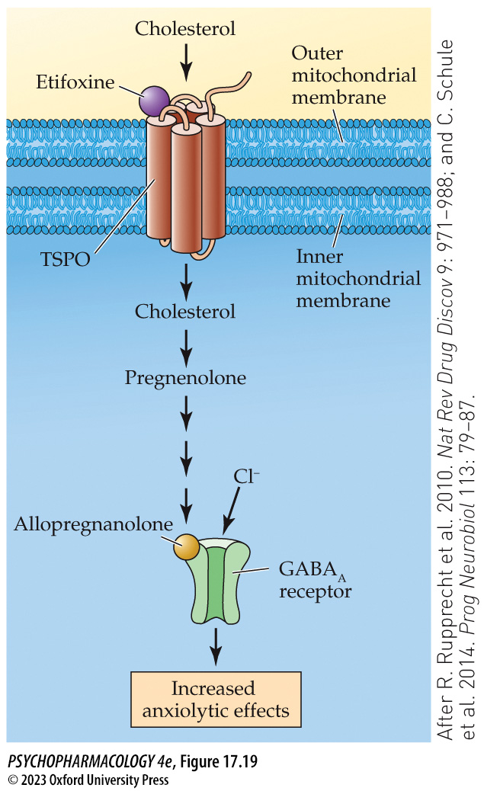
FIGURE 17.19 Neurosteroid synthesis
Notes:
FIGURE 17.19 Neurosteroid synthesis
TSPO is a translocator protein that is located on the outer mitochondrial membrane and transports cholesterol through the inner mito­chondrial membrane. The conversion of cholesterol to pregnenolone is the rate-limiting step in neurosteroid synthesis. Pregnenolone is further modified in several steps to allopregnanolone, which binds to the GABA_{A} receptor modulatory site to enhance GABA-induced chloride influx, producing anxiolytic effects. Etifoxine is one drug that targets TSPO to increase neurosteroids and reduces anxiety. (After R. Rupprecht et al. 2010. Nat Rev Drug Discov 9: 971–988; and C. Schule et al. 2014. Prog Neurobiol 113: 79–87.)

Slide 59
Drugs for Treating Anxiety, OCD, and PTSD (7 of 10)
Second-generation anxiolytics produce distinctive clinical effects
Buspirone (BuSpar): partial agonist at 5-HT_{1A} receptors; does not enhance GABA action
Advantages: reduces anxiety and depression without sedation or mental clouding, does not enhance other sedative–hypnotics, has no withdrawal syndrome or abuse potential
Disadvantages: slow onset of anxiolytic effects; ineffective for relieving alcohol or barbiturate withdrawal, insomnia, or seizures; lack of muscle relaxant effects
Notes:
Instructor Notes:

Slide 60
Drugs for Treating Anxiety, OCD, and PTSD (8 of 10)
Antidepressants relieve anxiety and depression
Anxiety and depression often occur together
SSRIs have a high therapeutic index and low abuse potential but take 4 to 6 weeks to show effectiveness
SSRIs side effects: increased anxiety, insomnia, sexual dysfunction; cause physical dependence
Tricyclic antidepressants and MAOIs can treat some anxiety disorders but have troubling side effects
A new drug (vilazodone) combines 5-HT reuptake inhibition with potent partial agonist activity at 5-HT_{1A} receptors
Notes:
Instructor Notes:
SSRIs include: clomipramine (Anafranil), fluoxetine (Prozac), fluvoxamine (Luvox), and sertraline (Zoloft)
Tricyclic antidepressants: imipramine (Tofranil)
MAOIs: phenelzine (Nardil), tranylcypromine (Parnate)

Slide 61
Drugs for Treating Anxiety, OCD, and PTSD (9 of 10)
Many novel approaches to treating anxiety are being developed
Ketamine has been successfully used in clinical studies to mitigate symptoms of OCD and PTSD
LSD and psilocybin have shown long-term efficacy in treating depression and anxiety when combined with psychotherapy
MDMA reduces existential anxiety in terminally ill cancer patients
It is thought that the dissociative, mystic, and empathogenic effects of these substances allows patients to safely identify and face the underlying trauma than with therapy alone
Notes:
Instructor Notes:

Slide 62
Drugs for Treating Anxiety, OCD, and PTSD (10 of 10)
CLICKER QUESTION 2
Which of the following is not a therapeutic use of BDZs?
Presurgical anesthesia
Deep anesthesia
Insomnia treatment
Muscle relaxation
Notes:
Instructor Notes:
Correct answer: b

Slide 63
Review of Learning Objectives (3 of 3)
17.3.1 Describe how barbiturates and benzodiazepines reduce anxiety by modulating GABA neurotransmission.
17.3.2 Detail the pharmacokinetics and side- effect profiles of barbiturates and benzodiazepines.
17.3.3 Recognize the characteristics of dependence and withdrawal from benzodiazepine abuse.
17.3.4 Describe the mechanisms of action and anxiolytic properties of neurosteroids, second-generation anxiolytics, and antidepressants.
17.3.5 Detail novel approaches to anxiety treatment, including the use of MDMA, ketamine, and hallucinogens as adjuncts to psychotherapy.

